Slide 1

Ravensbourne Valley Residents Association
AGM – Thursday 2nd March 2023
The role of your local councillors
Julie Ireland and Graeme Casey
Liberal Democrat Councillors for Bromley Town

Slide 2
The role of a local councillor
Locally:
Talking to constituents / listening to the community / keeping the community informed
Casework
Attending Council Meetings – scrutiny, regulatory, planning
Working with local organisations and stakeholders
Debating / influencing borough-wide policy
Representing the people of our ward

Slide 3
Talking to constituents
Surgeries
Emails
Newsletters
Public Meetings
Consultations
Social media
Leaflets
Street letters
Street Stalls

Slide 4
Casework
Plenty!

Slide 5
Attending Council Meetings
Scrutiny
Regulatory
Planning
Full Council

Slide 6
Working with local organisations and stakeholders
Police
Safer Neighbourhood Panel
Community organisations
Schools
Residents’ Associations
Charities
Churches

Slide 7
Representing the people of our ward
Local planning consultations (local plan, SPD, etc)
Protecting community assets
Supporting local businesses
Tall buildings!
Making our area a better place to live and work

Slide 8
Influencing council policy
Working with the council members and officers to see if we can influence local policies

Slide 9
The role of a local councillor
Outside of our ward:
Feed into national policies
Working with our MPs to influence and interpret government policies that affect people in our wards
Campaigning for the local, regional and national party

Slide 10
The role of a local councillor
Campaigning
Working for issues we believe in
Getting re-elected!

Slide 11
How much time does it take?
A part time job
Could easily be full time
For most people it’s a few hours a day or 2 complete days
Except for ….

Slide 12
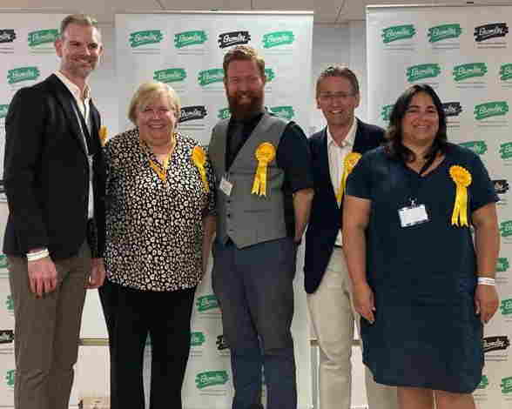
Would we do it again?
?

